Slide 1


Team 71: Virtual Computer Mouse using mmWave Radar (TI) Bi-Weekly Update 4
Oscar Chavez Araiza
Greyson Heath
Daniel Lu
Zane Meikle
Sponsor: Texas Instruments
TA: Vishwam Raval

Slide 2
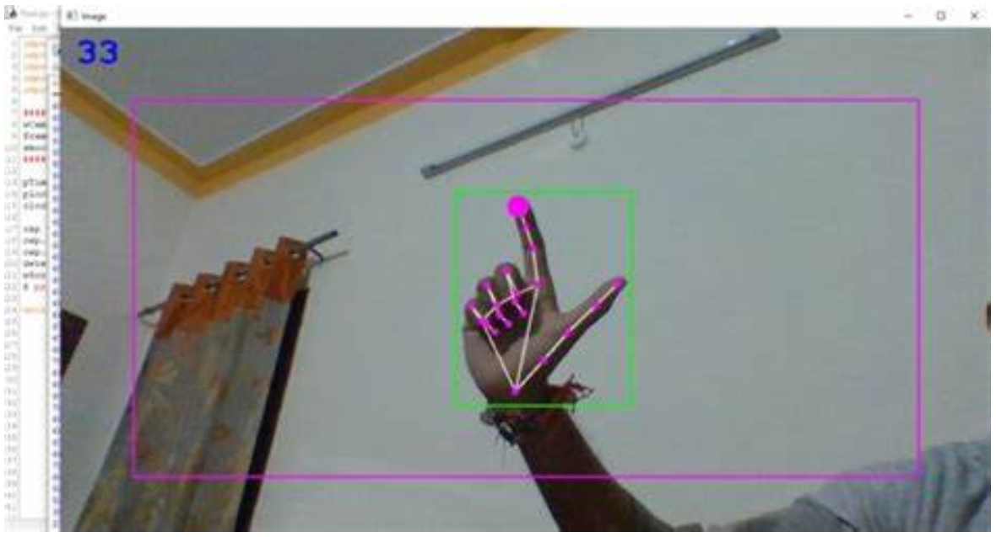
Project Summary:
Problem statement:
Virtual mice today are traditionally done using computer vision and a camera (as seen on the right).
But these systems are processing and power intensive.
High-level summary:
Create a virtual mouse using a Texas Instruments (TI) mmWave Radar and a ML model to make a less power and processing intensive virtual mouse.
#71 - Virtual Mouse using mmWave Radar (TI)

Slide 3
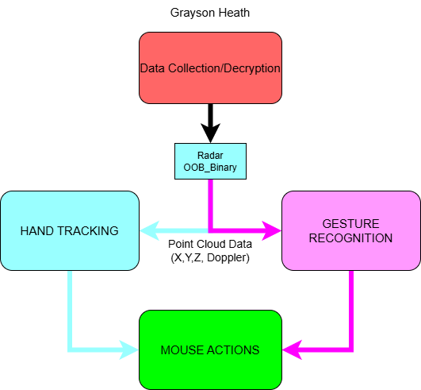
System Overview
#71 - Virtual Mouse using mmWave Radar (TI)

Slide 4
Major Project Changes for 404
Currently, we are integrating what we have. Afterwards, we plan to do the following proposed changes:
Interactive GUI - Provides feedback and sensitivity adjustments (Greyson)
Improving AI for gestures - New gestures for holding clicks (Oscar)
Mouse frame smoothing - Connect point A to point B with arbitrary frames to smooth motion (Zane)
Parallelization of scripts - Parallelize the different scripts so they aren't running in one program (Zane)
Improving accuracy - improve the accuracy of the mouse (Daniel)
Radar enclosure case - Protects devices and looks presentable (Greyson)
#71 - Virtual Mouse using mmWave Radar (TI)

Slide 5
Project Timeline
#71 - Virtual Mouse using mmWave Radar (TI)

Slide 6
Chirp Config / Collect Data
Greyson Heath
Hours since last presentation <11> hrs | Ongoing progress/problems and plans until the next presentation
<6> Integrating and Threading/Queueing GUI R&D <4> Resizing Case and Adjusting CAD Model <1> Sponsor Alignment Meeting | Old case did not properly support the radar when placed inside Plan on speaking with sponsor tomorrow about monitor mounting and lid ideas. Will print case following confirmation
#71 - Virtual Mouse using mmWave Radar (TI)

Slide 7
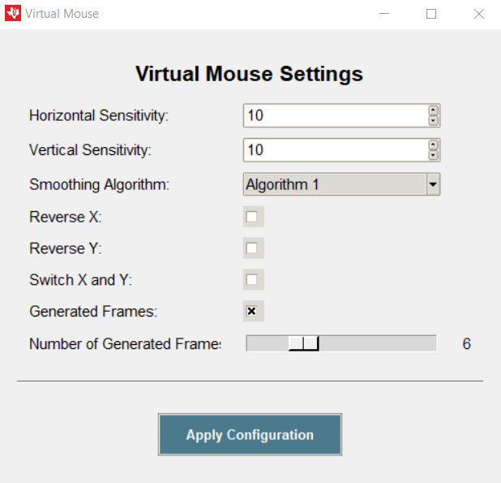
Settings GUI
#71 - Virtual Mouse using mmWave Radar (TI)

Slide 8
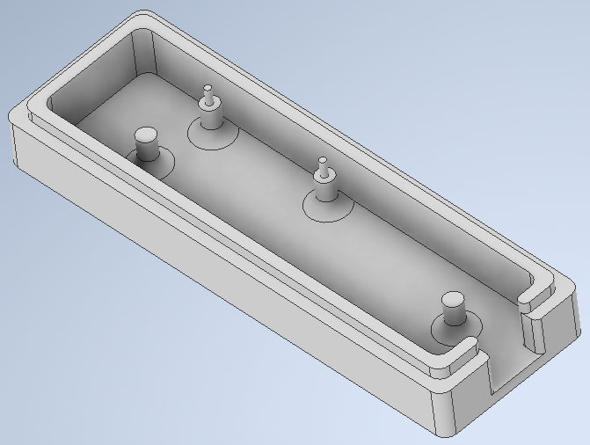
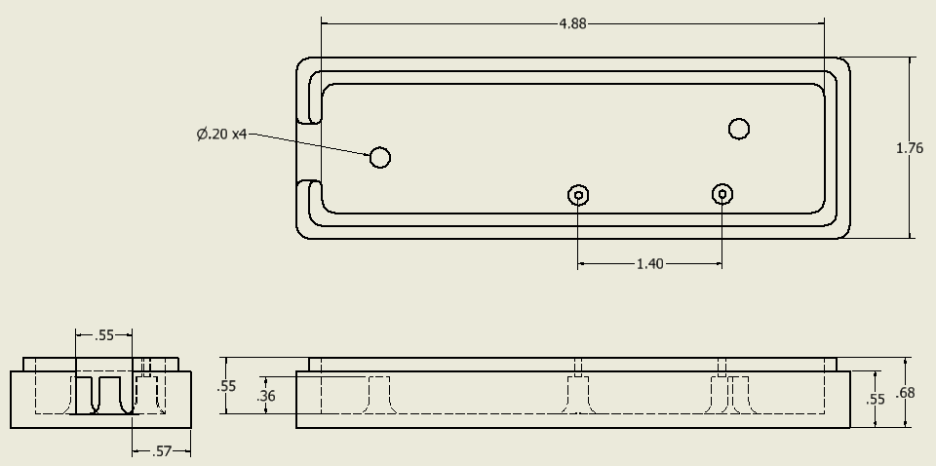
Updated CAD Model (Bottom)
#71 - Virtual Mouse using mmWave Radar (TI)
#71 - Virtual Mouse using mmWave Radar (TI)

Slide 9
-Gesture Recognition-
Oscar Chavez Araiza
Accomplished since 403 <~14> hrs | Ongoing progress/problems and plans until the next presentation
<1> Meeting with sponsor <4> Looked for the angle bins to recreate the position from the gesture recognition binary. Not successful. There seems to be a hidden layer of computation in the binary. <4> Continued to work on the smoothing of the mouse control. <5> Training the ML model | Problems If the hand is too close to the radar, the data is noisy and the cursor moves without the hand moving. If the hand moves too fast the on-board CPU overloads (only when using a threshold of 0dB). Progress I’ve arrived at a radar configuration that will reduce the amount of noise capture by the radar, but it also reduces the amount of total points obtained
#71 - Virtual Mouse using mmWave Radar (TI)

Slide 10
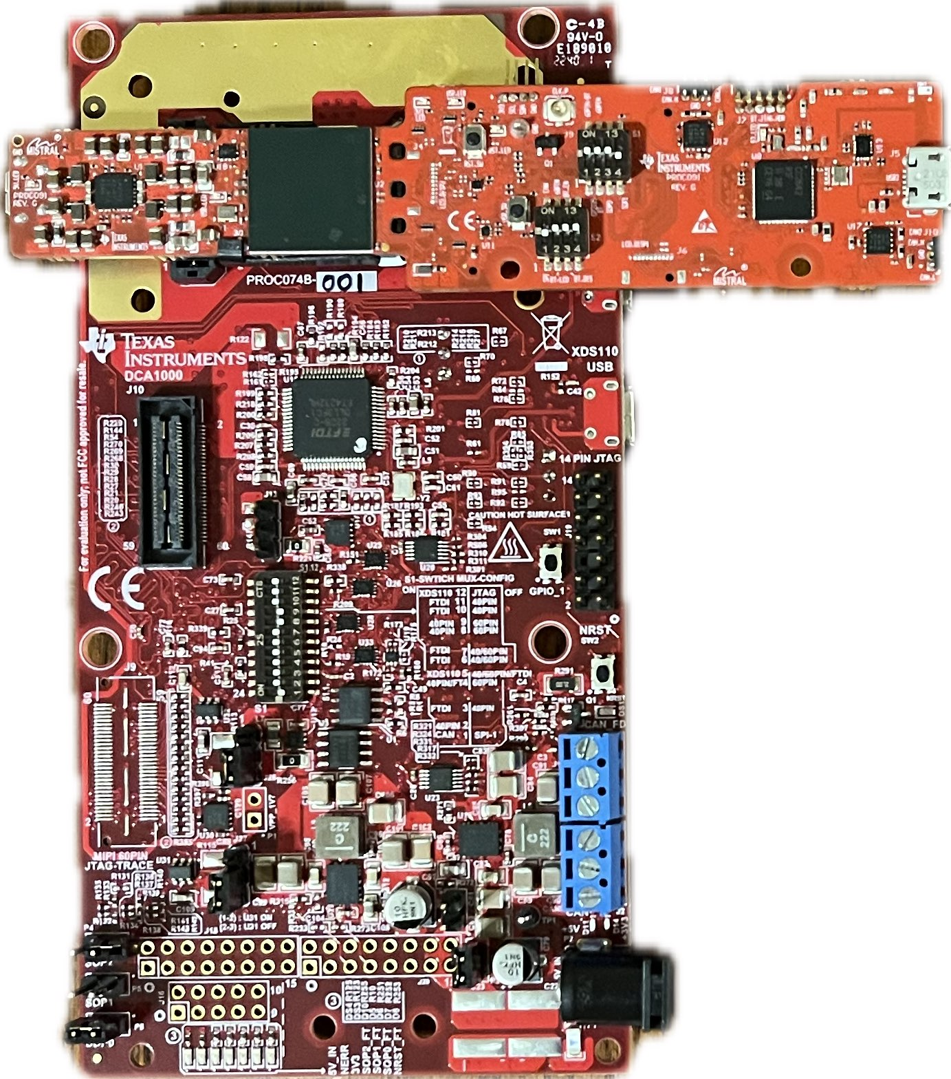
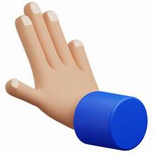

New Gesture Added
PULL GESTURE

Slide 11
Gesture Layout
PUSH: Left-Click (hold & release)
PULL: Double Left-Click
SHINE: Right-Click
We expect to add one more gesture that will be responsible for a simple Left-Click.

Slide 12
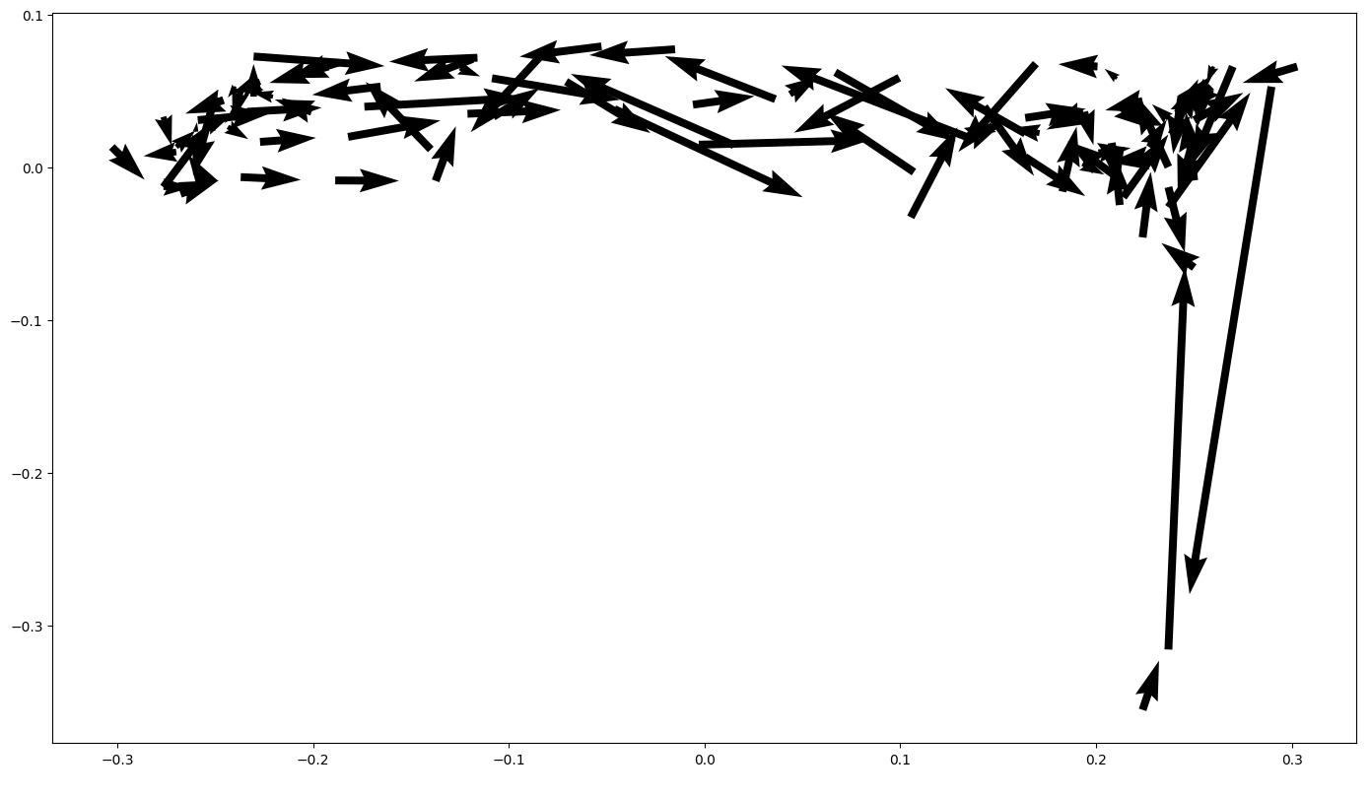
Vector map (Updated)
y (m)
x (m)
Left-to-Right Movement Vector Map
#71 - Virtual Mouse using mmWave Radar (TI)

Slide 13
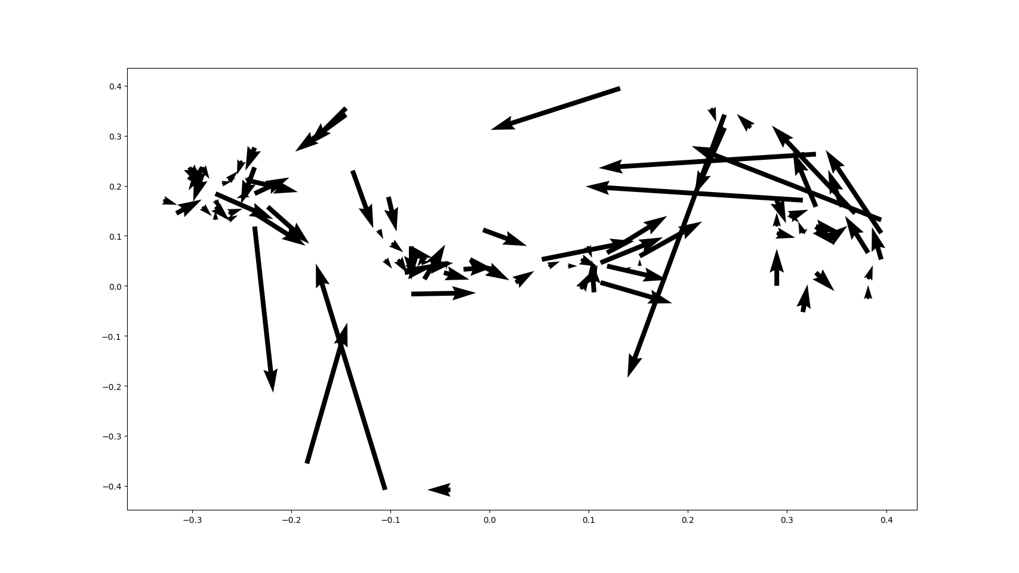
Vector Map
Back and Forth Movement at Ideal Distance

Slide 14
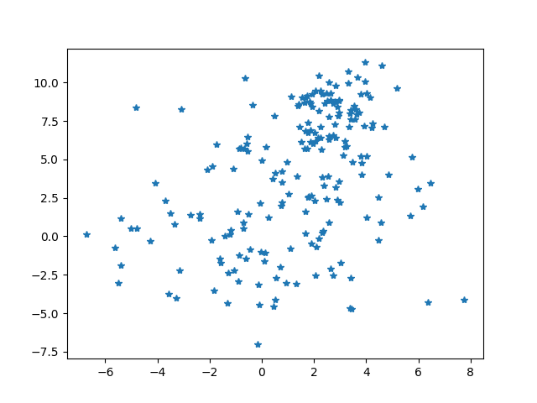
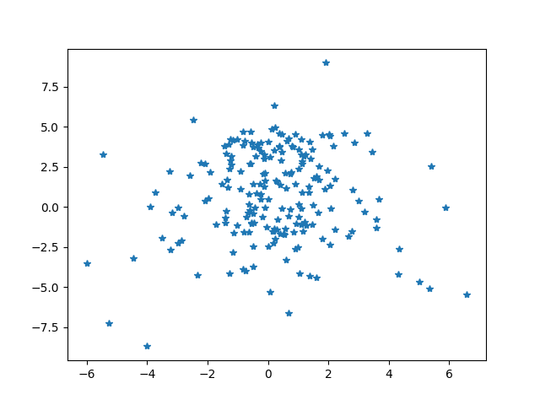
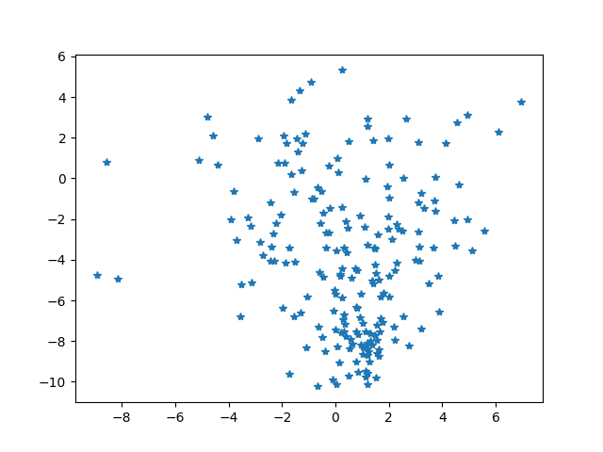
Using Gesture Features for Position
Shine Up
Shine Center
Shine Down

Slide 15
Gesture Positioning
Daniel Lu
Accomplishments <10hr> | ECEN 404 ongoing progress/problems in the next 2 weeks
Combine the weight average velocity and geometric mean demo <7hr> Working on combining the gesture positioning demo with our final project demo <3hr> | Problem : the radar randomly generate data points from the environment
#71 - Virtual Mouse using mmWave Radar (TI)

Slide 16
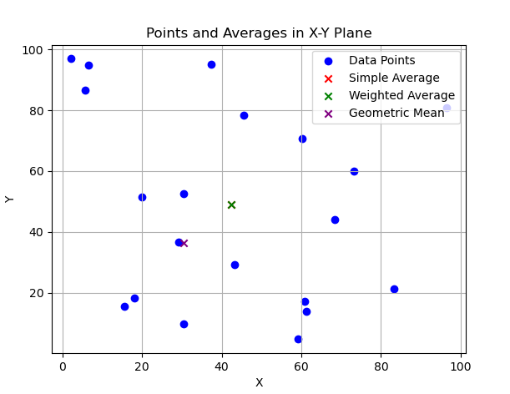
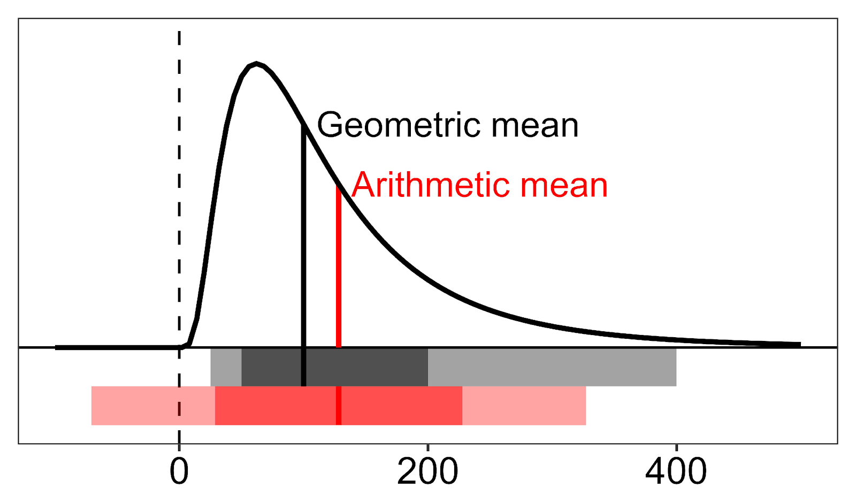
#71 - Virtual Mouse using mmWave Radar (TI)

Slide 17
Vector map
Left-to-Right Movement Vector Map
#71 - Virtual Mouse using mmWave Radar (TI)

Slide 18
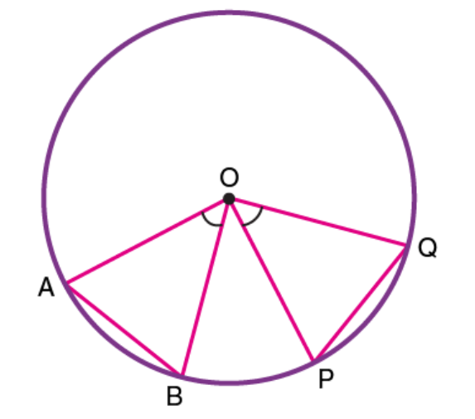
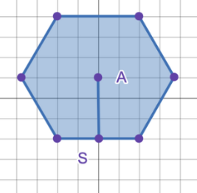
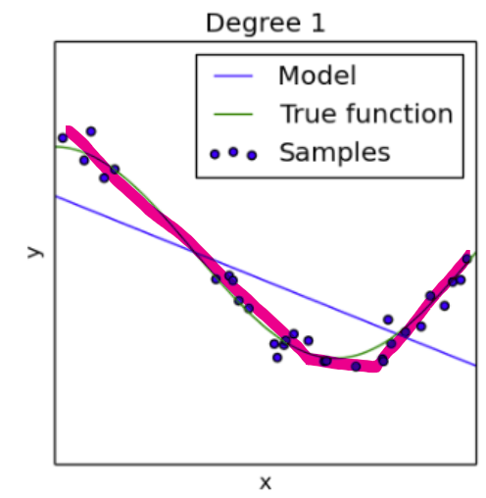
average weight trending line solution

Slide 19
Input Mapping
Zane Meikle
Accomplishments since the last presentation <8> hours | Ongoing progress/problems and plans until the next presentation
<5> Finishing and debugging frame smoothing (frame gen) <3> Working on integrating frame gen and GUI | Problems: Me and Greyson realized that it is somewhat backwards for us to integrate just our parts. Ongoing Progress: Working on integration. Plans: Next lab me, Oscar, and Greyson will work on full integration based off the current code Daniel and Oscar are working on.
#71 - Virtual Mouse using mmWave Radar (TI)

Slide 20
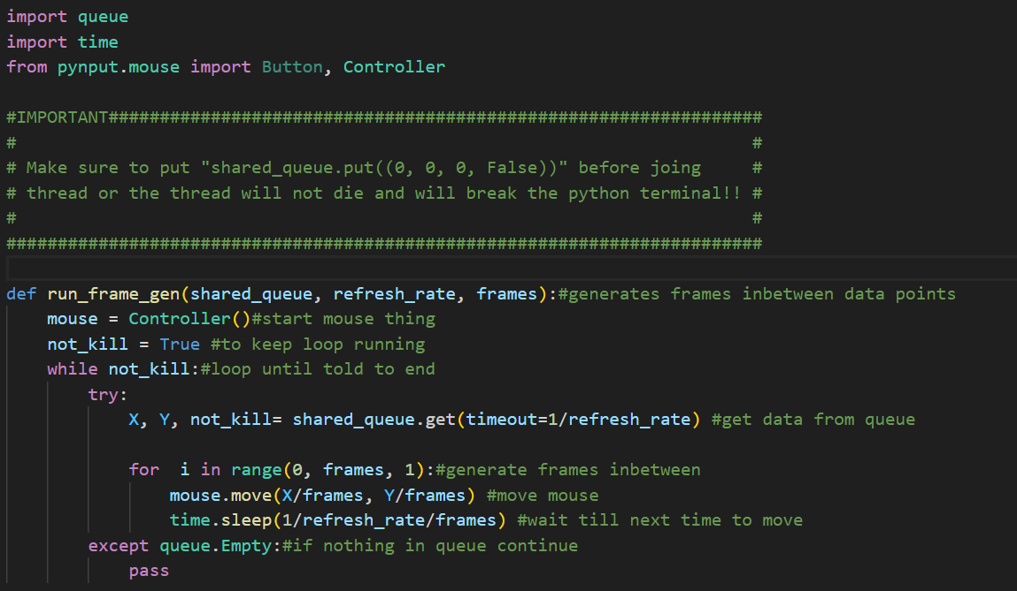
#71 - Virtual Mouse using mmWave Radar (TI)

Slide 21
Parts Ordering Status
We do not need any new parts as such we haven’t ordered any.
#71 - Virtual Mouse using mmWave Radar (TI)

Slide 22
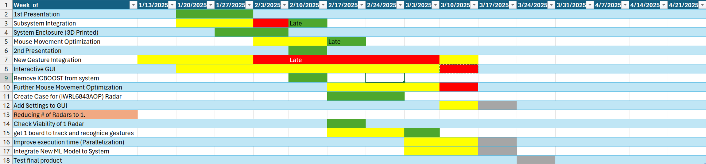
Execution Plan Gantt Chart
#71 - Virtual Mouse using mmWave Radar (TI)

Slide 23
Validation Plan
Section | Task | Specification | Result | Owner
3.2.1.6 | Mouse Movement | Mouse can be moved to all corners of the screen by the program. | Passed | Zane
3.2.1.6 | Mouse Actions | The program must be able to right click and left click. | Passed | Zane
3.2.5.2 | Mouse Input Error Handling | The program must properly handle all invalid inputs. | Passed | Zane
3.2.1.4 3.2.1.6 | Gesture positioning | The coordinates of the gesture should be calculated when deleting the error points. | Passed | Daniel
3.2.1.6 3.2.1.8 3.2.3.2.1 | Velocity accuracy | The output velocity of the moving gesture should not have errors. | Passed | Daniel
3.2.1.5 | Hand Gesture Recognition | ML model can recognize the users hand gestures | Passed | Oscar
#71 - Virtual Mouse using mmWave Radar (TI)

Slide 24
Validation Plan
Section | Task | Specification | Result | Owner
3.2.1.5 | Gesture Recognition Accuracy | ML model can correctly identify and categorize hand gestures at least 90% of the time. | Passed | Oscar
3.2.1.7 | Functional Radar System | The IWR6843AOPEVMs, and MMWAVEICBOOSTs all properly communicate with the computer and transmit data. | Passed | Greyson
3.2.1.8 | Data Decoding | The python script accurately decodes the TLV data seen from both radars. | Passed | Greyson
3.2.1.3 3.2.1.4 | Radar Angle and Distance | The radars can capture gestures and pointer positions within a 90 degree range up to 1.5 feet | Passed | Greyson
3.2.1.5 | Hand Size | Radar will recognize gestures regardless of hand size. | Passed | Oscar
#71 - Virtual Mouse using mmWave Radar (TI)

Slide 25
That is all, thank you.

